Slide 1

IST 659: Data Admin Concepts and DB Mgmt. E-Commerce Analytics Schema Syndicates
Raghuveera Narasimha
Rithika Gurram
Kruti Kotadia
Rithvik Rangaraj
Mansi Gopani
Deep Patoliya

Slide 2

Project Description
Our Project, Optimized eCommerce Analytics is dedicated to leveraging data-driven insights to enhance insights to enhance efficiency, improve user experience and drive business growth within our platform.
With a robust database housing comprehensive information across various tables, our goal is to extract meaningful and actionable insights.
We use Data-driven decision making strategies leading to more effective marketing strategies and increased sales.
We Identify top categories, explore user behavior correlations, and uncover seasonal patterns.
Use data analysis techniques, emphasizing preprocessing, statistics, and visualization.
Formulate actionable strategies based on insights for improved marketing and inventory.
We Improve user experiences based on personalized interactions and product recommendations.

Slide 3
Database Overview
Database Name: ”Ecommerce Analytics"
Tables:
Number of tables is 15
Data Types:
Data types like varchar, decimal, int, and date are utilized for diverse data representation.
Indexes:
Clustered indexes on primary keys optimize data retrieval by improving storage and access performance.
Constraints:
NOT NULL and UNIQUE constraints are implemented, contributing to data integrity and accuracy.
Normalization:
The database design follows at least 3rd Normal Form, minimizing redundancy and ensuring consistency.
Database Settings: Compatibility, ANSI, auto-update statistics, and Query Store, optimize performance and management.

Slide 4
Navigation Diagram
Python Script to generate Rows
Deployment in Microsoft Azure
Visual Analytics in Power BI.
Database Creation In SSMS

Slide 5

Business Questions
”Crafting personalized experiences and targeted marketing campaigns hinges on robust data analysis to comprehend and adapt to individual consumer preferences.."
”Efficiently balancing sales optimization and minimizing surplus stock demands effective inventory management, accurate demand forecasting and precise product identification.”
How does leveraging data analytics provide businesses with a substantial advantage in a competitive market, influencing decision-making across marketing tactics?."

Slide 6

Methodology
Data Acquisition:
Tools and Software:
Provide a brief overview of the tools and software, such as SQL, Python, Excel and Microsoft Azure are used for data analysis.
Data Preprocessing:
Outline key data preprocessing steps, including cleaning procedures, handling missing values, and techniques for standardization.
Functionality and Integration
Summarize the functionalities of any custom code or algorithms developed.
Explain how the dataset was obtained, whether through web scraping, API access, or direct provider delivery.
Explain how these custom elements seamlessly fit into the analysis pipeline.

Slide 7
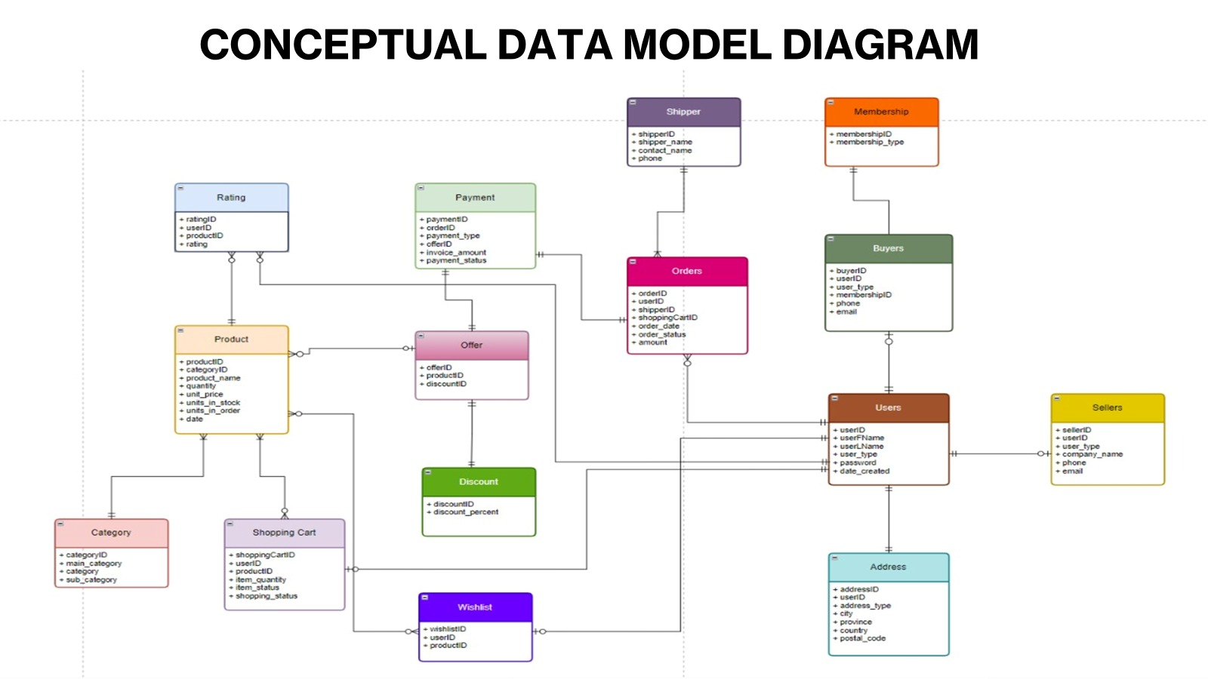

Slide 8
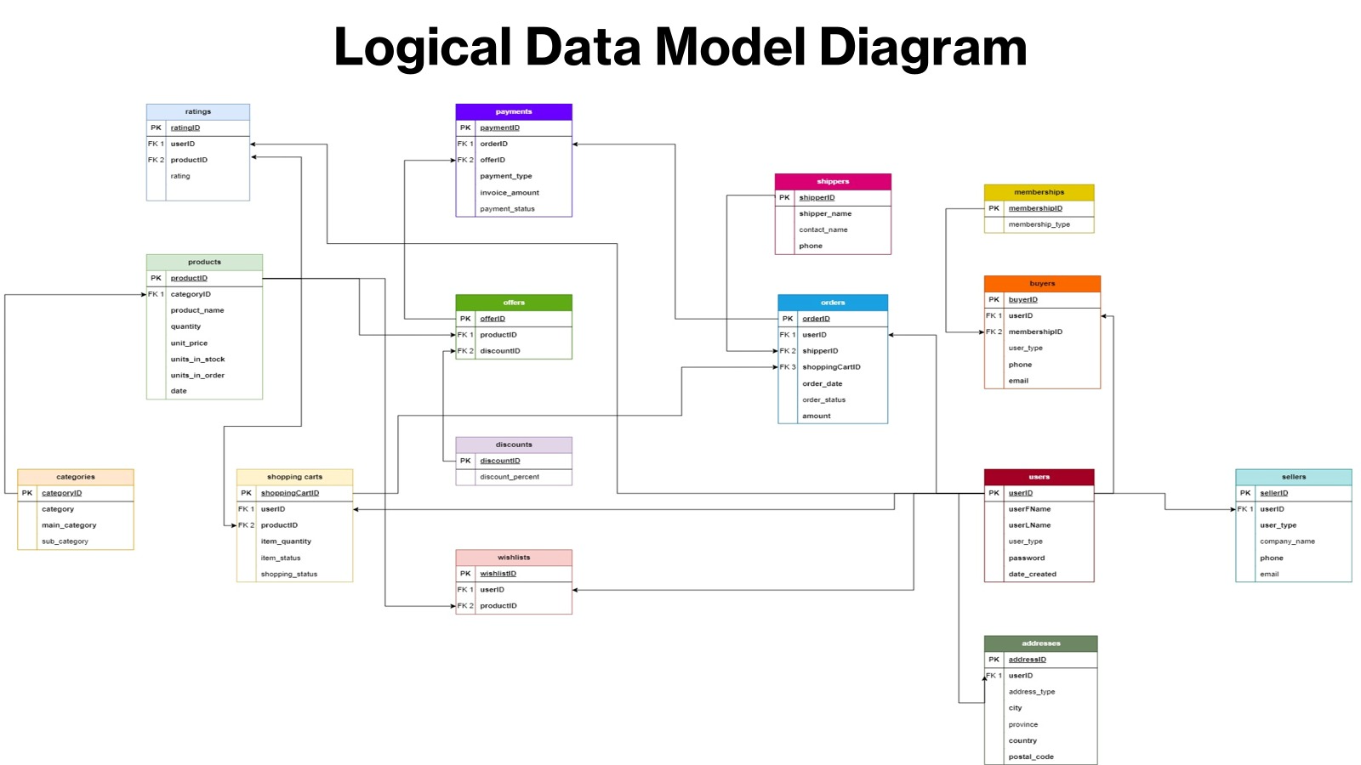

Slide 9
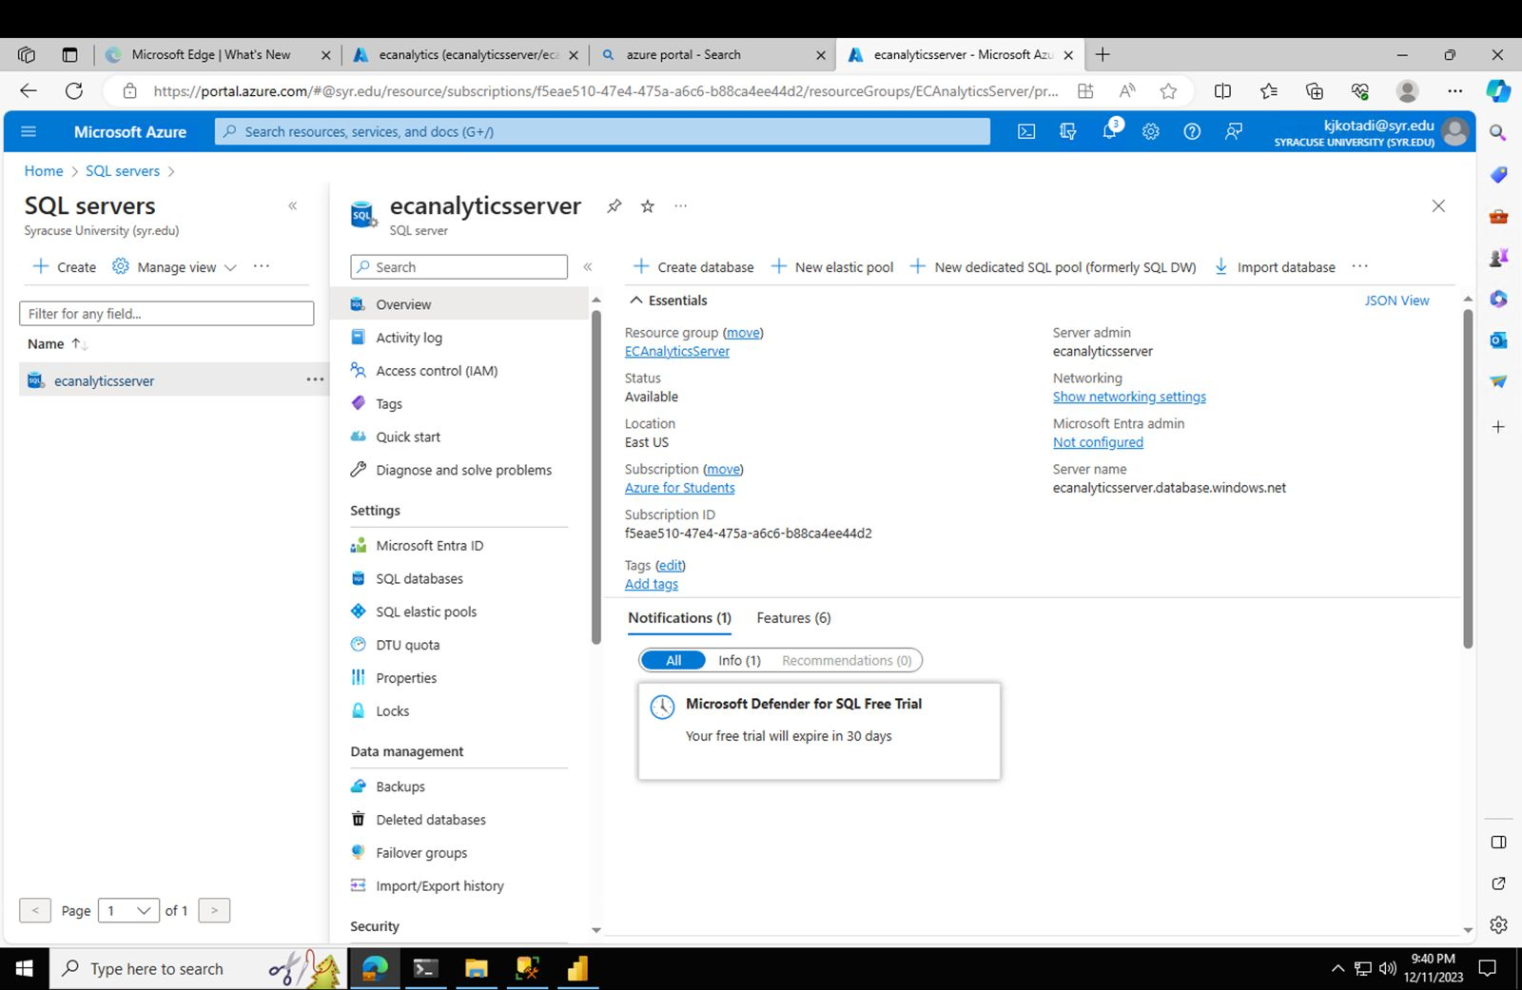
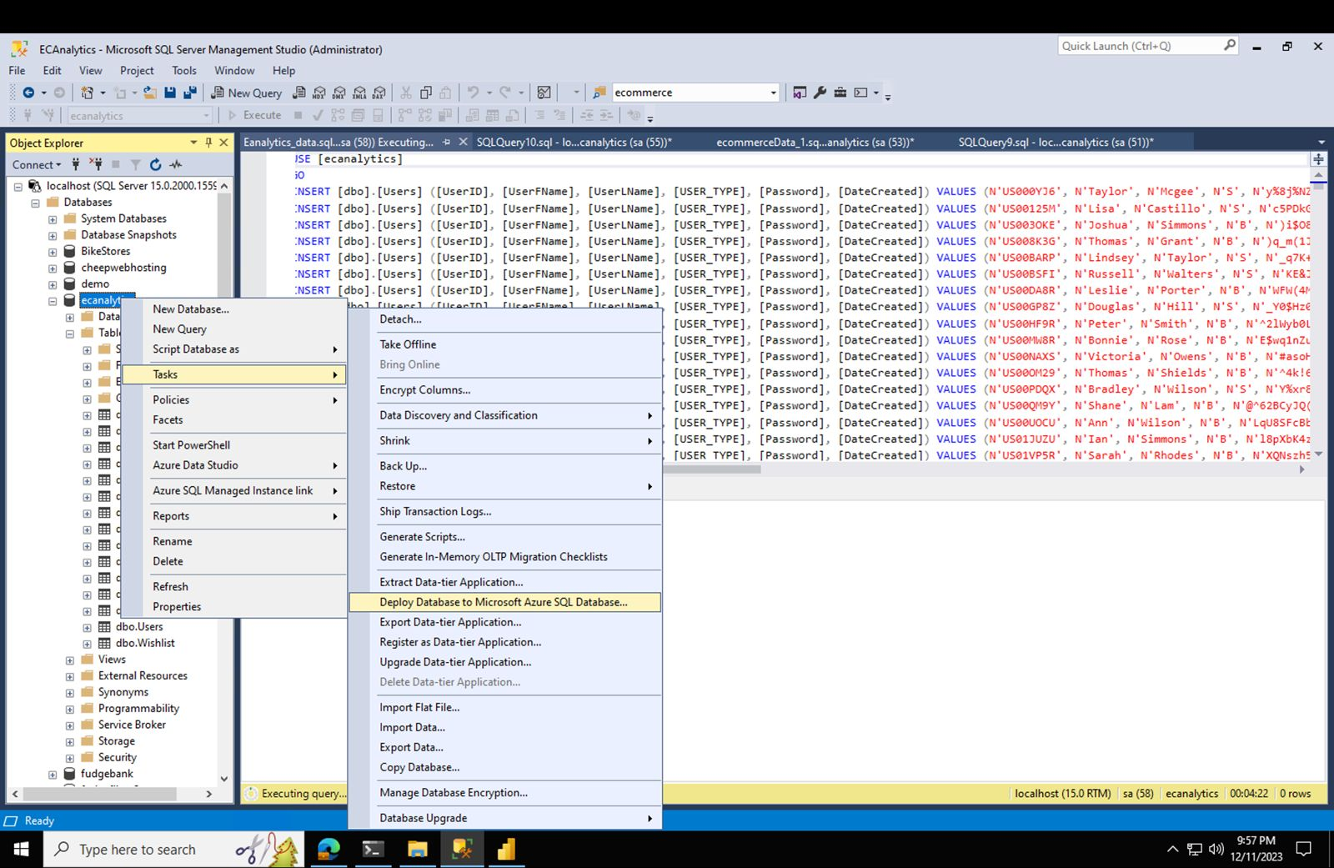
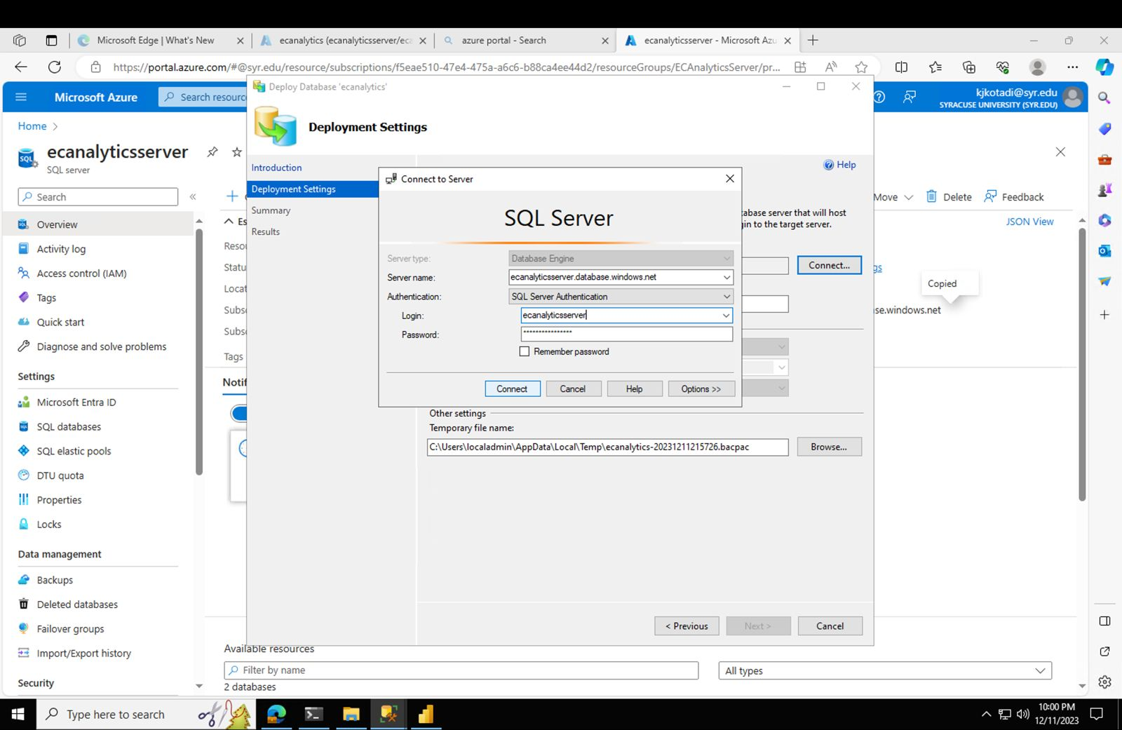
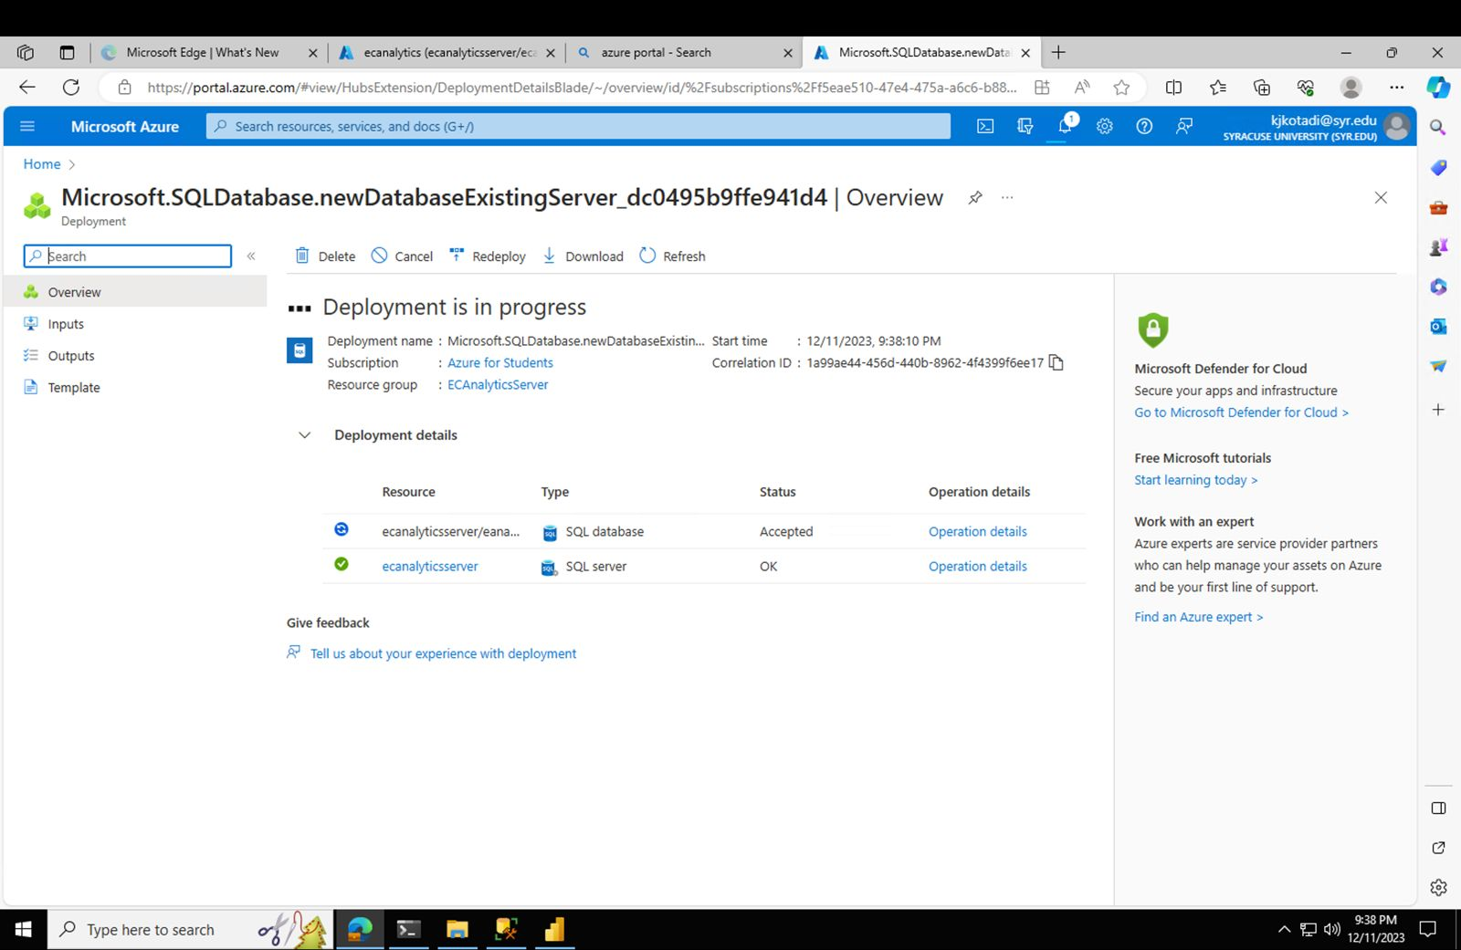
Deployment on Azure

Slide 10
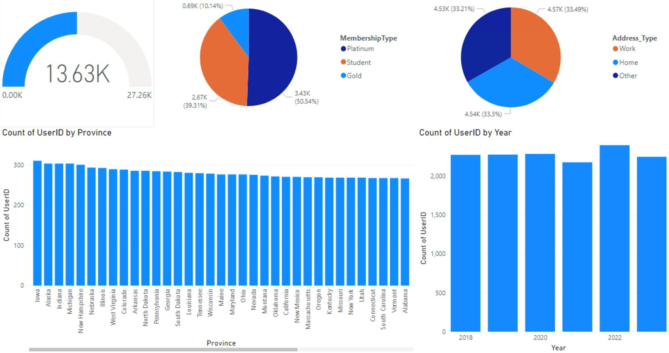
Visualization of Power BI
Users with Province, Membership Type, Year and Address type.

Slide 11
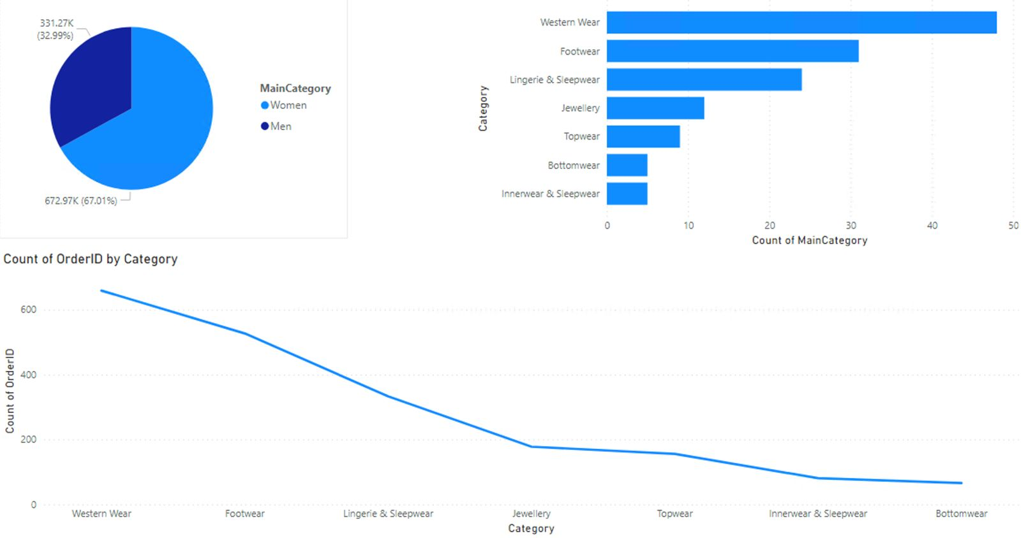
Product with OrderID, MainCategory and Invoice Amount

Slide 12
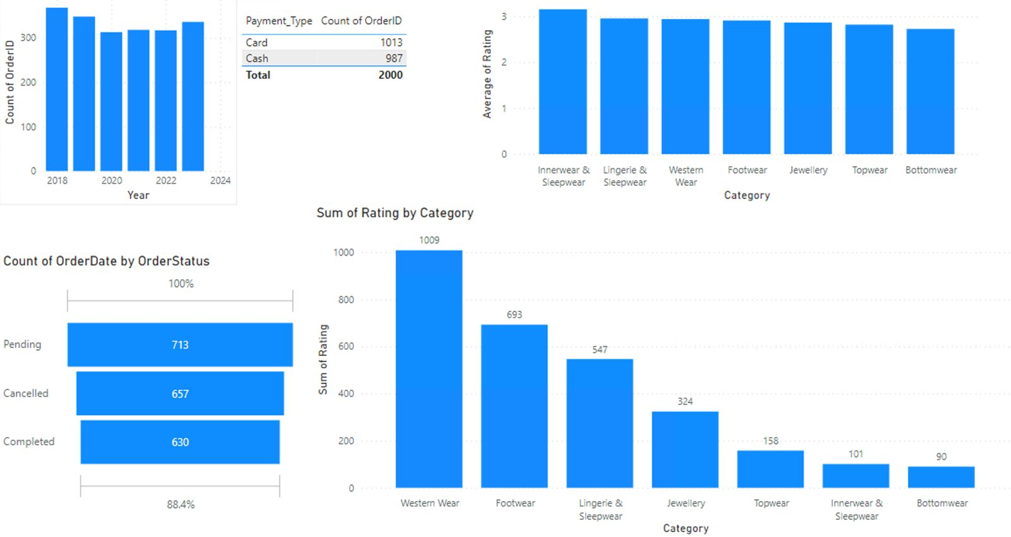

Slide 13
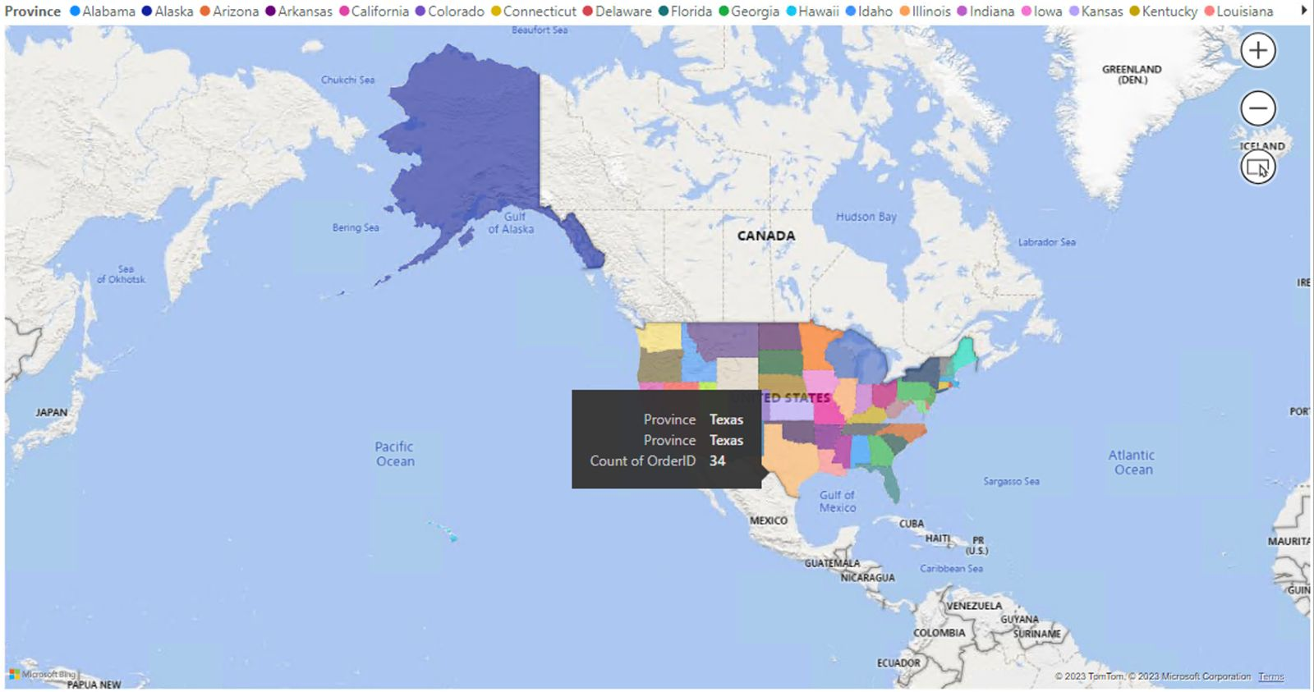

Slide 14

Actionable Insights
We need to target the Gold membership category for promotions, as they represent the largest segment.
We need to develop tailored marketing strategies for different address types since their distribution is nearly equal.
We should consider location-based marketing campaigns since user distribution varies by province.
We must allocate more resources to women's product lines and marketing to capitalize on the higher sales volume.
Consider strategic promotions for men's products to increase their sales share.

Slide 15
Actionable Insights
We can investigate the low number of sleepwear orders; consider whether it's a stocking issue or lack of customer interest.
We can explore strategies to convert pending orders to completed to improve sales figures.
Meantime, we can investigate the reasons behind the high cancellation rate to enhance customer retention.
The customer satisfaction ratings suggest there is room for improvement in all categories. Initiatives to increase product quality or customer service may positively impact these ratings.

Slide 16

Conclusions
Based on the visual data analysis, the actions that should be most focused on are:
Improving Customer Retention: Address the high cancellation rate by understanding the underlying reasons and implementing corrective measures.
Enhancing Customer Satisfaction: Improve the average rating across product categories through quality improvement and better customer service.
Order Conversion: Develop strategies to reduce the number of pending orders and increase the conversion to completed orders.
These actions are likely to have the most direct impact on revenue and customer loyalty.

Slide 17
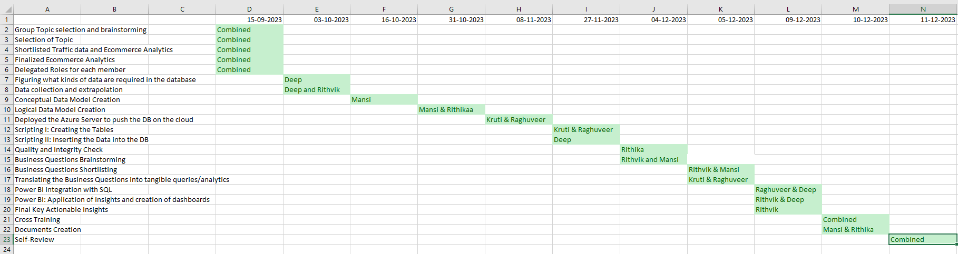
Team Log Sheet

Slide 18

Thank You and Have a Great Vacations : )

